Slide 1


IDMC Factory – Capgemini Delivery Capability
Insights & Data, August 2025

Slide 2

What Makes Our Informatica/Capgemini Partnership Unique?
Our Partnership
Enablement & Certifications
Global Capabilities
Partner Award & Analysts Recognition
Overall 1500+ resources are certified globally
800+ IDMC Certifications
IDMC certification drive for 2025 currently on
IDMC Factory : CoE’s
PC2IICS | MDM
CDGC | CDQ
Years of Partnership
13+years
2023 Cloud Modernization Partner of the Year
2023 GSI Partner of the Year APAC
2022 Global GSI Partner of the year for Cloud Modernization
2022 GSI Partner of the year for EMEA-LATAM and Asia Pac
Gartner named Informatica a Leader in five Magic Quadrant Reports 2021 – Click here
Informatica Is a Leader Again in Gartner 2021 Magic Quadrant for Data Integration Tools – Click here
2020 GSI Partner of the year EMEA-LATAM
2020 GSI Partner of the year Australia
2018 Innovation Partner of the year
Global Partner
Highest level of partnership
Core offers / Solutions
IDMC Factory For Modernization
Transforming Data Powered Offerings – Data Market Place, Data Trust
Dedicated Global Alliance Director, Technical Alliance Manager, access to Product teams and Chief Architects
AE2AE connects
IDMC Accelerators
PC2IICS (CDI): Modernization
IDQ2CDQ: DQ Modernization
EDC/AXON2CDGC: DG Modernization
MDM2MDM SaaS: MDM Modernization
OUR CROSS-INDUSTRY FOOTPRINT
Automotive
Aerospace & Defense
Banking
High Tech
Life Sciences
Telecommunications
Energy & Utilities
Insurance
Public Services
Consumer Products & Retail

Slide 3
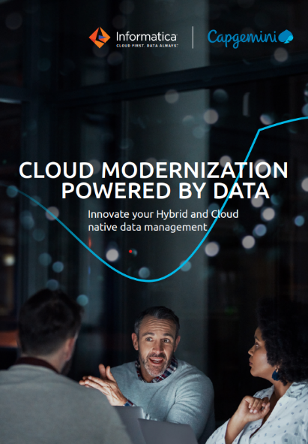
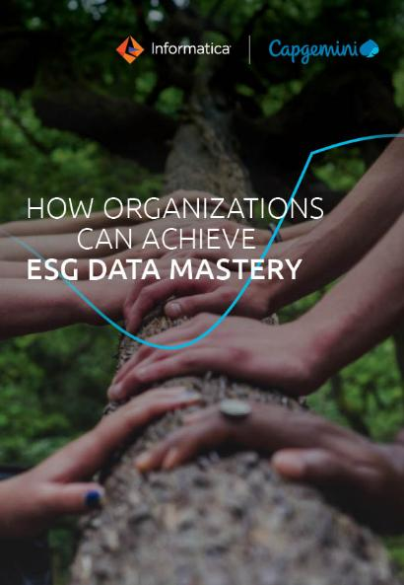


Thought Leadership, Joint Publication and GTM Motions

Slide 4


AI & Data Engineering Reference Architecture
Data Trust
Generative AI Ready
Data & AI
Enterprise
Landscape
COLLABORATIVE DATA ECOSYSTEM
Third Party Solutions
DATA & AI POWERED APPLICATIONS
Open Data
Marketing & Sales
Supply Chain
Finance & Compliance
Production
Loyalty
Campaign
CRM
Inventory
PLM
General Ledger
Carbon footprint
Assets Management
External Marketplaces
COLLABORATIVE DATA ECOSYSTEM
Social Data
Partners
DATA TRUST (MANAGEMENT)
Bridge
Data Governance Strategy, Culture, Organization & Process
Data Lake (bronze / raw data)
DATA & AI POWERED APPLICATIONS
Collect
Collect
Publish
Publish
Publish
Publish
Data Catalog
Business Glossary
DATA FOUNDATION
DATA FOUNDATION
DATA AS PRODUCTS & MODELS ENGINEERING
INSIGHTS ACTIVATION
Data Capture
(stream & batch & api)
Data as Products Hub
(source-aligned, aggregated, consumer-aligned)
Marketplaces
(Federated, by organization, by domain)
INSIGHTS
ACTIVATION
Marketplaces
(Federated, by organization, by domain)
Data Discovery & Lineage
Data Quality
Data Lake
(silver / cleansed data)
Data Lake
(Gold / curated Data)
Discovery & Search
(Semantic, Visual)
DATA AS PRODUCTS &
MODELS ENGINEERING
Data
Preprocessing
(profile, clean)
Data Validation
(Audit, Balance,
Control, Reconcile)
Data
Engineering
(data preparation, enrichment)
AI
Engineering
(ML models design, train, deploy)
Gen AI
Engineering
(fine tuning, pre-training)
Semantic
(Data warehouse, Graph) (NoSQL, Vector, Virtualization)
Gen AI Orchestration
(CostOps, Cascading)
Self Service & Guided Insight Development
(Visualize, Report, Analyze)
Prompt Optimization
Data as Product, Data Mesh Governance
Data Marketplace Governance
RAG
Self Service Generative AI
(Workbench, Content Generation)
DATA FOUNDATION
Master Data Management
Models Hub (machine learning models, LLM: foundational fine tuned & pre-trained)
Self Service AI
(Design, Train, Deploy, Orchestrate, Workbench)
Self Service AI
(Design, Train, Deploy, Orchestrate, Workbench)
DATA TRUST
(MANAGEMENT)
Data Lifecycle
Data Protection
PLATFORM FOUNDATION
Hybrid and Multi cloud Operations
Data Platform Operations
Cloud Foundation Services
Automation
Network Connectivity
Edge Integration
Accelerators Templates
Monitoring & Alerting
Cyber
Security
PLATFORM FOUNDATION
GenAI
Guardrails
GenAI LLM Evaluation
Cyber
Security
DevSecOps/DataOps
MLOps/LLMOps
Automation
Cloud Data Services Automation
Security & Governance
Cloud Green FinOps
Data Green FinOps

Slide 5


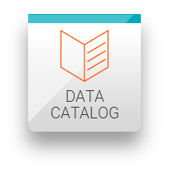
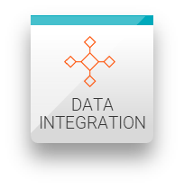
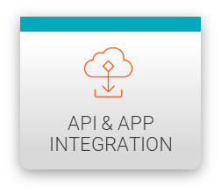


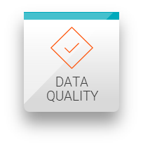
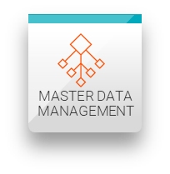
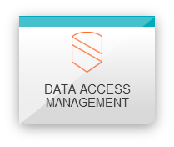


AI & Data Engineering Reference Architecture Framework – Expanded view with IDMC components
Data & AI
Enterprise
Landscape
COLLABORATIVE DATA ECOSYSTEM
Third Party Solutions
DATA & AI POWERED APPLICATIONS
Open Data
Marketing & Sales
Supply Chain
Finance & Compliance
Production
Loyalty
Campaign
CRM
Inventory
PLM
General Ledger
Carbon footprint
Assets Management
External Marketplaces
Social Data
Partners
DATA TRUST
Bridge
Data Governance Strategy, Culture, Organization & Process
Collect
Collect
Publish
Publish
Publish
Publish
Cloud Mass Ingestion
DATA FOUNDATION
DATA PRODUCTS & AI MODELS ENGINEERING
INSIGHTS ACTIVATION
Data
Catalog
Business
Glossary
Data Capture
Data Products
Hub
AI Models
Hub
Marketplaces
Core
Data Lake (gold)
Partner
Data
Discovery
Lineage
Data
Quality
Data Lake (bronze)
Discovery
Search
ELT Spark Pushdown
ELT Spark Pushdown
ELT Spark Pushdown
Partner
Prompt
Optimization
genI
Orchestration
Self Service
Insights
Data
Preprocessing
Data
Validation
Data
Engineering
AI
Engineering
genAI
Engineering
RAG
Data Product
Data Mesh
Governance
Data Marketplace
Governance
Partner
Core
Core
Core
Model serve
Model serve
Self Service
genAI
Data Lake (silver)
Semantic
Partner
Partner
Self Service AI
Master Data
Management
Data
Lifecycle
Partner
Partner
Partner
Partner
Data
Protection
PLATFORM FOUNDATION
Hybrid and Multi cloud Operations
Data Platform Operations
genAI
Guardrails
genAI LLM
Evaluation
Partner
Partner

Slide 6














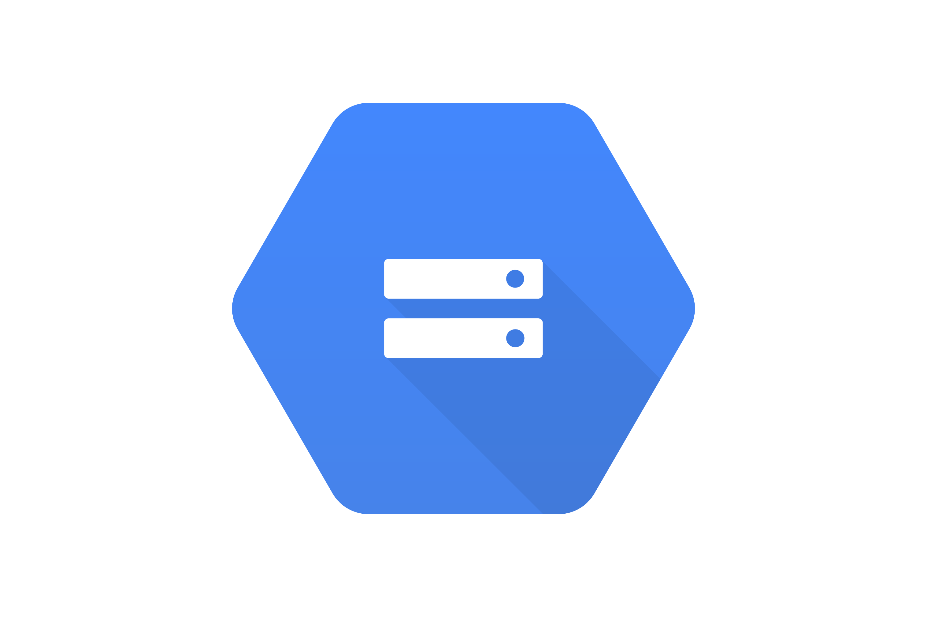

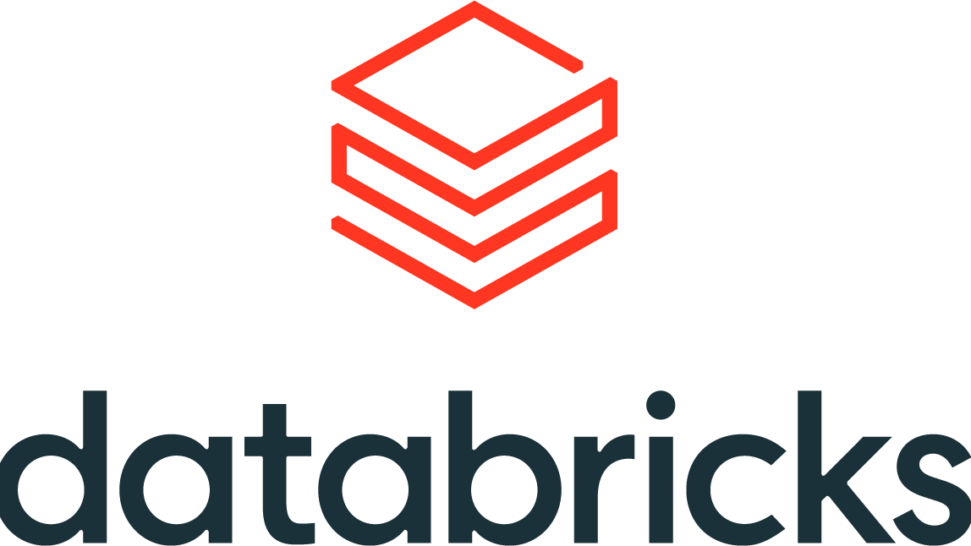




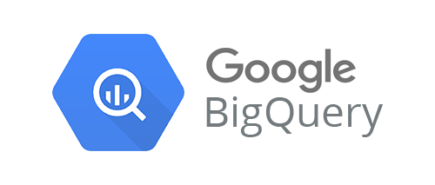
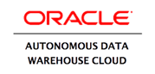






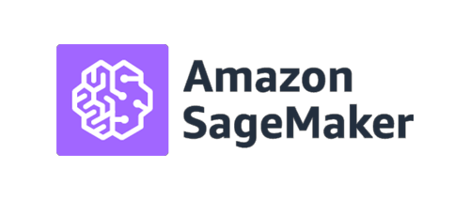



Informatica Data Management Cloud (IDMC): Full support for next-gen data platforms
Stream Processing
Stream Storage
Hybrid
Google Cloud Pub/Sub
360 Applications
Business User
CLOUD DATA LAKE
Data Integration
Data Quality
MDM
Data Analyst
SaaS
Landing
Zone
Data Enrichment
Enterprise
Zone
Data Ingestion
Google Cloud Storage
Azure Data Lake
Storage Gen2
Data Delivery and Marketplace
Data Integration
Cloud Data Warehouse
Line of Business
Google BigQuery
Azure Synapse
Analytics
Cloud
Data Science / AI
Data Engineer
Storage
Elastic Compute - Spark
Azure Machine Learning
API & Application Integration
Data Scientist
IoT
Data Catalog
Governance Manager
Governance and Privacy
CLAIRE: Intelligence and Automation
IDMC

Slide 7






How IDMC supports the components of Data Trust
CAPGEMINI’S DATA TRUST PROPOSITIONS, GLOBAL REACH, EXPERIENCE AND A POWERFUL COMBINATION OF BUSINESS AND TECHNOLOGY CONSULTING LEVERAGES METHODOLOGIES AND TOOLS WITHIN OUR DATA FACTORY IDEA BY CAPGEMINI:
2
DATA CATALOG
3
DATA CATALOG
Data Catalog
Business Glossary
GOVERNANCE & PRIVACY
1
Data Governance Strategy, Culture, Organization & Process
Creates/maintains an inventory of data assets through discovery, description and organization of distributed datasets (systems, databases, data lakes etc.) and their relationships, enabling data stewards, data/business analysts, data engineers and other data consumers to find and understand relevant datasets
Contains the semantic description of enterprise-wide business concepts and data standards, usually in the form of detailed business term definitions for critical data attributes and their relationships to each other, with examples, exceptions, synonyms, lineage, business rules, context notes and data ownership
Establishes data as a business asset, defines data ownership, ensures Business/IT engagement, develops the data organization and operating model, enforces data policies and processes, and promotes data literacy and culture
4
Data Discovery & Lineage
5
Data Quality
6
Data as Product, Data Mesh Gov., Data Marketplace Governance
7
Master Data Management
DATA
QUALITY
The process of discovering the organization’s data assets (data repositories, data domains, entities & attributes) as well as their lineage and traceability (system interfaces).
Measuring and visualizing data quality (Data Profiling) across a range of data quality dimensions, and of cleansing, enriching or otherwise improving the data quality, with a focus on high-priority strategic and operational metrics, by applying hygiene rules and functionalities, making it fit for purpose
Data Mesh is an architectural and organiza-tional paradigm that seeks to decentralize and distribute ownership and responsibility of data delivery to people who are closest to the data, providing a standardized set of Data as Products for self-serve data consumption, often via data marketplaces
MDM is a tool-based approach towards building the single view of master data and reference data (single source of truth, or golden copy), based on a variety of source systems that all hold similar, though incomplete master data
360 APPLICATIONS
360 APPLICATIONS
DATA CATALOG
MASTER DATA MANAGEMENT
DATA MARKETPLACE
8
9
GOVERNANCE & PRIVACY
10
11
Data Lifecycle Management
Data Privacy/Protection
GenAI Guardrails
GenAI LLM Evaluation
The lifecycle of enterprise data assets is managed via data retention, data archiving, data disposition policies that document specific timings, methods, target repositories and relevant compliance regulation, with specialized tools configured to perform recurring or one-off lifecycle management tasks
Regulations such as GDPR and HIPAA require organizations to apply specific controls to Personal Information concerning protection, consent and disposal. They require solutions centred around data discovery, classification, security and the ability to mask or delete data, typically through MDM-related solutions.
Safety mechanisms offering guidelines and boundaries to ensure that AI applications are being developed and aligned to meet ethical standards and societal expectations. Well-designed guidelines enable organizations to unleash the full potential of generative AI while mitigating the associated risks.
Assessing Large Language Models: will the candidate LLM adhere to ethical standards (fair, unbiased, respectful of diversity), societal expectations (values, norms, well-being), safety mechanisms (against harmful or inappropriate content) and compliance with regulatory requirements
DATA
QUALITY

Slide 8

IDMC Factory

Slide 9
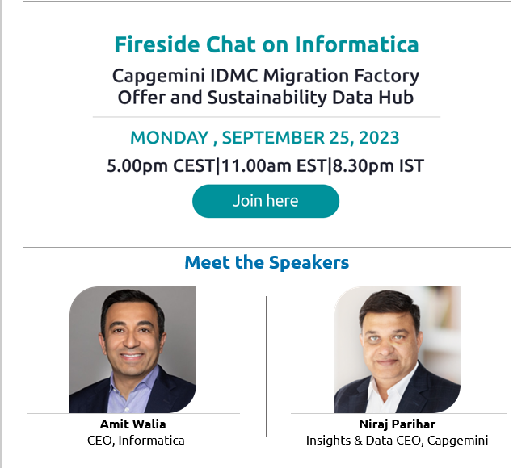
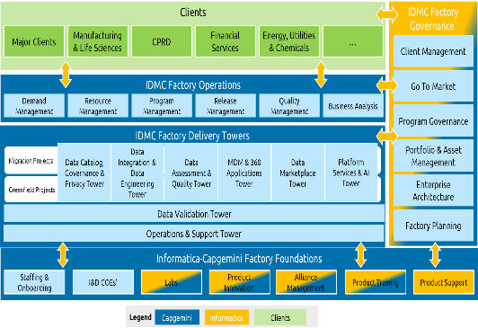
Capgemini’s Informatica IDMC Factory: Inception Overview
A 13-year strong and proven partnership at the highest level…
… re-energized with a joint vision from the highest level…
… is being addressed at scale with a joint operating model
Global Partner, a highest level of partnership
2023 Cloud Modernization Partner of the Year
2023 GSI Partner of the Year APAC
2022 Global GSI Partner of the year for Cloud Modernization
2022 GSI Partner of the year for EMEA-LATAM and Asia Pac
Gartner named Informatica a Leader in five Magic Quadrant Reports 2021 – Click here
Informatica Is a Leader Again in Gartner 2021 Magic Quadrant for Data Integration Tools – Click here
2020 GSI Partner of the year EMEA-LATAM
2020 GSI Partner of the year Australia
2018 Innovation Partner of the year
Customer-Centric Operating Model

Slide 10
IDMC Factory: Driving Digital Transformation & Cloud Modernization
Assets / Toolkit
Approach/Framework
Value / Solution Plays
Accelerators
Reference Architecture
Comprehensive Approach framework addresses E2E data management needs by integrating IDMC services
Integrated data platforms & Next generation data management solutions e.g. Data Trust
Accelerators for New Use case Build & Migration Program
Future-Ready Architecture
Industry-Level Strategic Collaboration
Product / Roadmap Level Connect
Collaboration on GTM activities
Talent Pool Development
Collaboration
Developing strategies & offerings at the industry level addressing common challenges, opportunities & trends
Ensure IDMC experts from Capgemini & Informatica guide clients through consultation, assessment, implementation & ongoing support
Joint GTM strategies through client presentations & collaborative marketing efforts to promote & sell product & solutions effectively
Targeted IDMC certification campaigns & product trainings to develop a large talent pool of certified resources, ready for immediate project deployment

Slide 11
IDMC Factory Delivers End-to-end Services with a Modular Approach
Factory Governance
Delivery Governance
Escalation Management
KPI monitoring & tracking
Engagement health checks
Collaboration with Informatica for product support
Factory Management Services
Demand Management
Resource Management
Project Management
Release Management
Quality Management
Knowledge Management
Service Introduction
Transition
1. PC → CDI Migration / Development
5. Data Validation & Testing
Planning
2. IDQ → CDQ Migration / Development
Maintenance
&
Support
Analysis &
Design
Onboarding
3. EDC / Axon → CDGC Migration / Development
Handover
Set up & Configuration
Deployment
&
Release
4. MDM → MDM SaaS Migration / Development
CLAIRE
Factory Enablers
Product Training
I&D CoE
Domain CoE
Innovation Lab
Knowledge Hub
Product Support

Slide 12

Migration Accelerators

Slide 13
IDMC Factory: Solution Accelerators
Overall, 16 IDMC solution accelerators have been developed across CDI, DG, DQ, MDM & DV
PC → CDI Migration
EDC / Axon → CDGC
IDQ → CDQ
MDM → MDM SaaS
Data Validation
Power Centre Modernization Toolkit:
Metadata Comparison F/W
Log Analyzer
Unsupported Source & Target Conversion
IDMC Code Review
IDMC Doctor
ABC Framework
Informatica Lineage X-Ray
IICS Job Monitoring
Informatica RPA utility & CDI-PC
Data Governance Modernization Toolkit:
Use Case Mapping Template
Axon Migration Utility
EDC Migration Utility
Data Quality Modernization Toolkit:
IDQ Code Assessment Utility
IDQ to CDQ Code Reconciliation Utility
Informatica’s IDQ to CDQ migration utility
MDM Modernization Toolkit:
Customized industry specific data models
Informatica's MDM SaaS migration utility
Data Validation Engine (DVE+) Tool:
Comprehensive validation scenarios & rules
Actionable validation results through comprehensive reporting module
30% - 40% Effort Reduction
20% - 30% Effort Reduction
20% - 30% Effort Reduction
25% - 30% Effort Reduction
40% - 50% Effort Reduction

Slide 14










IDMC Factory: Conversion Approach
Assessment
Informatica Assessment report
PowerCenter Analysis Toolkit
Operational Metadata , obsolete objects
Architecture reassessment
Analysis & Design
Conversion
Inventory Revalidation
PowerCenter Analysis toolkit (SQLs for metadata repository)
Code metadata
Operational metadata
Design Best practices
Informatica Migration factory (Auto)
SQL Queries conversion
Auto Code comparison
Planning & Architecture
Planning and prioritize the releases.
Solution Approach
Capgemini Implementation Methodology & framework
Best practice, coding guidelines, standards (ETC)
Build
Go Live & Hypercare
Manual code build
Coding Standard validation
Code validation for best practices
Knowledge DB
Run-book / Object Inventory List
Report on Performance benchmarking
Handover
Iterative Approach
For Each Release
Parallel Runs / UAT
Validate / Testing
Delivery Dashboard
Recon / Data Validation framework
Performance benchmarking
PowerCenter Operational Metadata
IICS operation metadata
Informatica Migration report on conversion (automated conversion from informatica)
Coding Standard validation
Reconciliation framework / Data Validation framework

Slide 15





IDMC Factory: Data Governance Migration Journey
Capgemini’s IDMC Factory
Use Case Prioritization for migration
Identify the respective assets from on-prem
Due Diligence
Define timeline and roadmap to implement
Pick relevant business assets from Axon (on-prem)
Perform asset mappings between on-prem and cloud version
Build automatic conversion templates as per cloud standards
Best Practices as applicable
Load the auto converted templates to IDMC and test
Build automated solution to migrate on-prem EDC details
Create auto Reconciliation & Migration summary report
Normal Flow
Accelerated Flow

Slide 16






IDMC Factory: Data Governance Conversion Solution
New ideas
Existing assets
Business Asset Conversion engine (Utility):
Convert JSON files to CSV format
Convert the CSV Axon format to CDGC format
Summary and reconciliation report generation
Informatica Axon file
Bulk Upload CDGC compatible Templates into IDMC Platform
IDMC platforml file
Running Python based Utility
Governance assets – CDGC
Facet identification and prioritization
Fully Convertible
Axon REST API Calls to pull the Facet detail with relationships
Glossary, System, Data Set, Process, Policy, DQ Business Rules
Glossary
System
Data Set
Process
Policy
DQ Business Rules
Glossary
System
Data Set
Process
Policy
DQ Business Rules
Deliverables:
JSON file having Axon Facet detail with relationships
Fresh Configuration
Facets like Org Unit, Workflows, Roles
Summary report
Technical Asset Conversion engine (Utility):
Convert EDC connection details into IDMC connection creation payload
Run the payload to import all connections into IDMC
Convert the EDC Lineage mappings into CDGC mapping template
Technical Assets- CDGC
Connection creation in Administrator
Run Metadata extraction and cataloguing
Upload any custom lineage
Informatica EDC file
Partially Convertible
Resources
Custom Lineage
Data Domains
EDC REST API Calls:
Pull Resource connection details
Pull lineage mapping
Deliverables:
JSON files of Resource name and connection details
& lineage mappings
Create all the connections
automatically into IICS (IDMC) leveraging IICS REST API and python-based utility
Create resources in Metadata Command and run the metadata extraction
Pull lineage mapping with EDC Rest APIs
Load the same into IDMC - CDGC
Potential Benefits: High effort reductions in leveraging the migration factory solution. Has reusable mapping templates and conversion engines for easy and seamless migration of information from on-prem to cloud version for the critical assets

Slide 17


IDMC Factory: Data Quality Migration Journey
Discovery, Strategy and Planning
Discovery, Strategy and Planning
Identify and document respective components/assets from on-prem
Capgemini
Due Diligence
Determine upgrade strategy
IDQ Code assessment
Implementation
Create code components (Mappings, Rules etc) in CDQ
Prioritize Departments/ BU’s for Migration
IDQ 2 CDQ param file converter
Validation
Best Practices as applicable
IDQ2CDQ Code reconciliation
Automation
Cutover and Parallel runs
Decommission & Sunset
Signoff
Migration Complete
Profile Orchestrator
Compare on Prem vs Cloud results for agreed upon period
Get sign off on migrated code and data
Decommission on premise system
Normal Flow
Accelerated Flow
Capgemini Acceletors/tool

Slide 18

IDMC Factory: Data Quality Conversion Solution
New ideas
Existing assets
Coder Converter
Conversion
IDQ Components
Projects
Applications
Workflows
Mappings
Rules/Mapplets
Mapping/Rule Specification
Profiles
Scorecards
Data services
Transformations
IDQ 2 CDQ param file converter
Fully Convertible
Examples:
Connections
Parameter files
Unix Shell Script
Job Orchestrator
IDQ Code assessment
IDMC components
Conversion Feasibility Analysis
Partially Convertible
Profiling
DQ Assets
CDI Assets
Examples:
Workflows
Mappings
Mapplets
Validation Rules
Repository
IDQ2CDQ Code reconciliation
CUSTOM Script
Manual Work
Object Validation
Scheduling Script
Unix Shell Script
Parameter files
IDQ Code assessment
Examples:
DQ Rules
Profiles
Scorecards
Fresh Build
Data Validation
Performance
Capgemini Acceletors/tool
* Back
Informatica Acceletors/tool

Slide 19
Execution Approach For Cloud Migration- indicative We recommend multiple waves based on Applications/Programs (to be finalized during assessment). Multiple waves may run in parallel
~ 2 – 6 months
Wave 1: IDQ to CDQ
Wave 2: IDQ to CDQ
Gap Analysis & MVP
Wave 1: IDQ to CDQ
Wave 2: IDQ to CDQ
Support
Wave 2: EDC-Axon to CDGC
Wave 2: EDC-Axon to CDGC
- - - - - - - - - - - - - - - - - - - - Each release comprises of the following phases - - - - - - - - - - - - - - - - - -
Key Activities :
Planning workshop
Gap analysis
New features
Customized code
Integration with third-parties
Re-estimation (if required)
MVP for CDQ and CDGC with identified use cases
Deliverables :
IDQ Inventory reports with Assets Detail
AXON/EDC inventory reports
Gap analysis
Revised effort, resource plan and schedule
Migration Strategy and planning
MVP DEMO on CDQ and CDGC
Conversion
System Testing
User Acceptance
Parallel runs
Go LIVE
Validated
1
2
3
4
5
Conversion and Unit testing
Integration
end to end loads
Sign off
Process run in both env
Go Live
Key Activities
Convert IDQ , AXON, EDC assets into IDMC & unit test
Configure Parameter files
Enablement of CDQ,CDGC,integration
Orchestration of Jobs for Workflow and Scorecards
Deliverables :
Unit testing document
Reconciliation Report
High level design document for the target environment
DQ Dashboard
Key Activities:
Seamless integration between workflows
Seamless integration between CDQ,CDGC
Reconcile with existing system’s metadata
Validation
Fix Defects
Deliverables:
Migration report
Validation report
DQ Dashboard in CDGC
Key Activities:
User Acceptance Testing
Testing for workflow
Testing for collective working of CDQ,CDGC
Validate data in extracts with DQ rules
Validate metadata and lineage
Fix Defects
Deliverables:
Dashboard, Reconciliation Report
Environment:
Production
Activities:
Reconciliation
Job scheduling
Data Validations
Issue Fixes
Deliverables:
Migration success report
Business Validation
Activities:
Secure Business Sign-off
Deliverables
Go-live communication
Run Book
Key Objectives:
Final touch points & catchup.
Transition & handover
Communication & training
Go Live
Retro / Inflight changes (keep it minimal)
Code Freeze*

Slide 20
Value additions from our IDMC Factory accelerators on DQ and DG
# no | Accelerator | Service | Value to Client | Phase of the Project | Effort Reduction up to
1. | IDQ Code assessment | DQ | Metadata driven assessment of inventory which gives more insights on inventory. | Assessment | ~20%
2. | Job Orchestrator | DQ | Automated script for bulk execution of multiple objects. | Execution | ~30%
3. | IDQ 2 CDQ param file converter | DQ | Assessment & conversion of Parameter file & convert IDQ parameter files to CDQ compatible | Execution | ~20%
4. | IDQ2CDQ Code reconciliation | DQ | Toolkit to compare metadata across from IDQ and CDQ repositories for reconciling the migrated objects | Execution | ~20%
5. | Reusable Use Case mapping documents | DG | Detail Use Case mapping sheet Individual Use Case component mapping sheets | Analysis | ~ 60%
6. | Automatic conversion of business templates | DG | Identifying the required API for authentication Identifying the required search APIs for extraction of information from different Axon facets Identifying the required search APIs for extraction of relationship among facets Leveraging the identified APIs to pull the required information from Axon | Design and Build | ~ 30%
7. | Automatic Resource connection & custom lineage establishment in IDMC | DG | Identifying the required search APIs for extraction of information from EDC Leveraging the identified APIs to pull the required details from EDC Automate the API Calls to pull the connection details for all EDC resource API calls to pull the lineage mapping details | Design and Build | ~25%
*The development of the accelerators are currently in progress

Slide 21

Learnings & Best Practices from Prior EDC-Axon/IDQ to IDMC Conversion Projects
Some features could be not present in target env. Develop a clear understanding of interdependencies, features in the target cloud environment with stakeholders. Discuss and come to an agreed solution.
Develop MVP and get alignment with Business before conversion.
No changes to be made to target architecture without through analysis to verify converted objects will work on new architecture.
Conversion process to be initiated once all prerequisite have been fulfilled.
Sufficient test data to be made available for unit testing for early discovery of issues prior to SIT / UAT.
Handle issues with pushdown optimization not getting enabled due to unsupported Informatica functions/features by redesigning the process. Get alignment with Business on the possible outcome during build phase also.
SIT /UAT environment needs to be populated with production data(or similar volume) to simulate the parallel runs and compare performance statistics.
SMEs to be engaged along with usage of documentation to understand logic of existing mappings, features.
Validation results to be reviewed with PepsiCo. SMEs/Stakeholders to verify they meet the expectations.
GAP ANALYSIS PHASE
BUILD PHASE
VALIDATION PHASE

Slide 22
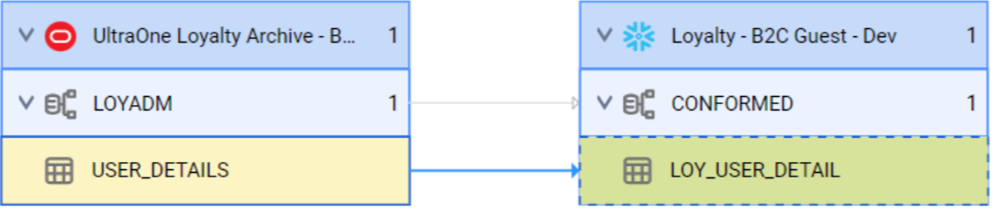
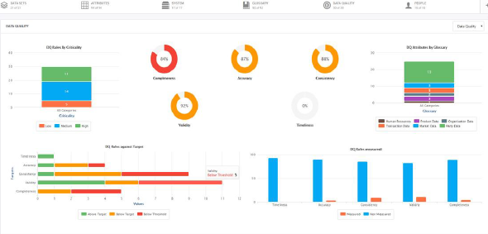







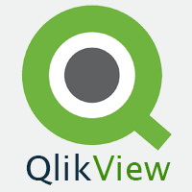

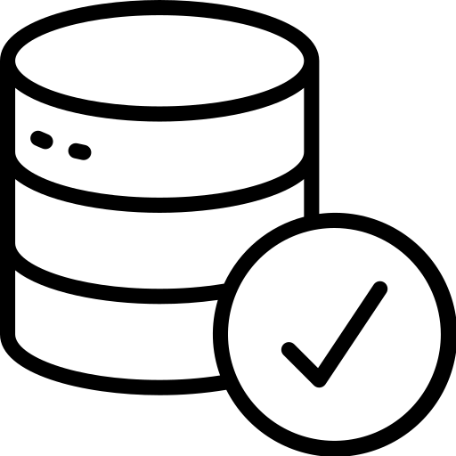

Data Cataloguing Process Flow Using IDMC Services
Metadata Sources
METADATA EXTRACTION
Metadata Association
/Lineage
Business Metadata & Governance
Governance
operationalization
Business Metadata
Client’s Data Governance Team provides the Business Metadata
Data Sets
Policies
Business Glossary
Processes
Domains , Sub-Domains
View
Technical Architects
Business Metadata Authorization
Data Lineage
Approver
Update & View
Business Stakeholders
Business Stewards
& Data Owners
Business
Glossaries/ Policies
Workflow
Dashboards
Technical Metadata and Lineage Sources
Governance through Workflows
Consumption
Technical Metadata
Extraction
Technical
MCC
Technical Metadata & Lineage
Change Management / Audit Trail
CDGC
Connectors
Biz – Tech Metadata Association
Associate
Secure Agent/Group
Data Sharing
Business Consumers, Data Scientists
DQ rule reference, score
Cloud Data Quality
DQ Integration with CDGC
Data Marketplace

Slide 23
MVP/Pilot Implementation for CDGC and CDQ: Activities & Deliverables
PHASE
Initial Assessment & Infrastructure Setup
Requirement And Design
Implementation
Installation, Configuration and environment setup
Assess & design
Integration with different products
/Pilot
KEY ACTIVITIES
Cloud environment provisioning (IDMC) by Informatica
Informatica Secure Agent installation
SSO enablement
Env configuration
Access permission configuration (role & responsibility configuration)
Requirement & Use Case identification for the implementation (Domains, Systems etc.)
Define MVP/Pilot Scope (high priority use cases)
Identify roles & responsibilities (for assigning ownership)
Prioritization of use case – high , medium, low
Collate existing Business Glossaries, policies, processes to be created during MVP
Identify CDEs in scope for data lineage and data quality
Identify DQ gap using column profiling
Identify and finalize validation rules
Design Governance workflows
Define metadata extraction process and data lineage strategy.
Identify classification rules
Identify Data Marketplace and access requirement
Catalog source systems and extract metadata
Load business metadata for the domains in scope
Modify Data classification rules and Configure new rules (as applicable)
Business metadata creation
Technical and business metadata association
Data Marketplace configuration and enablement
Data Access Management – configuration and policy enablement
Create rule specification/mapplet
Cleansing, standardization and error reporting, alert etc.
Workflow development
Interaction with business stakeholders on validation
Schedule DQ jobs
Documentation
DELIVERABLES
Operational CDGC environment
Business Requirement Document
Implementation plan
Functional design
Column profiling report
Operational & implemented Data Cataloging solution
Exception reporting
DQ Scorecard in application
Improved DQ at target DB
User Guide/Operational Manual (for Business and Technical Users)
~ 8 weeks

Slide 24
Appendix

Slide 25
IDMC Factory: PC Conversion Solution
Conversion
Fully Convertible
Code Deployed to IICS (DI)
PowerCenter Objects
Extract workflows and mappings in XML format stored in a folder
Review
Examples:
Update strategy, Java Transformation
Re-verify target order
Re-verify parameters
Workflow, Worklets
Command task
Objects Validation*
Parameter files
IICS - CDI
Utilities for PC code Conversion
Partially Convertible
Properties Validation*
Projects
Workflows
Mappings
Session
Folder Creations
Connections
Standard Validation*
PC to CDI Utility
For Conversion
Examples: Pre and Post SQL Commands.(re-pointing)
User Defined Functions
Unconnected Stored Procedures, Salesforce Look up
XML Transformation
SQL Transformation
Partitioning
Data Validation*
PC Code Analysis*
SQL
Conversion*
Row Count
Core Re-write
Testing
Scripts (Need to check)
Scripts (Unix)
Linux/Window Server Agent will be leveraged
Unix/Windows scripts will be placed in the Secure agent server and called from pre and post commands
Also, all the directories , parameter files, source files will be placed in the secure agent server.
Data Validation*
Data Reconciliation*
Scheduler
Currently Power Center Schedules is leveraged
Re-write the same in IICS
There are two options
IICS scheduler similar to one in PowerCenter (considered in solution)
3rd party scheduler can be leveraged to call IICS job
Performance

Slide 26
IDMC Factory: On-Prem MDM to Cloud Conversion Journey
Capgemini’s Informatica Master Data Management
(CoE)
Initial assessment for portability
Export change list from on-prem
Due Diligence
Finalizing Assets to be Migrated
Fixing data anomalies (if any)
Data Validation Report identifying data anomalies
Analysis Report identifying Assets to migrate
Migrating the required assets to SaaS
Best Practices as applicable
Build Phase
Build Phase
Refactor code not migrated through migration utility
Validate and finalize the code Migration
Data Migration
Data Validation

